Slide 1
EENG 284 Introduction To Quartus and Verilog

Slide 2
Lab Objectives
Working with the Quartus IDE
Verilog skills
Creating logical expressions in Verilog
Concurrent Signal Assignments
Simulation
Working with testbenches
Working with Questa (run command)
Creating timing diagrams
Verifying design

Slide 3
Lab 1
You can now start work on lab 1.
Go to course canvas module Labs
Under Lab 1, you will find this presentation for your reference ‘Lab 1 presentation’ and the lab assignment document ‘Lab1’ .
Follow the instructions in the document to complete your lab.
Deliverable Dates
Demo at the start of the next lab session.
Upload PDF at the start of the next lab session.

Slide 4
Lab 1
As you complete the ‘how to’ at the start of this lab, you will find that you have already completed part1 of Lab 1: a 2-input AND gate!

Slide 5
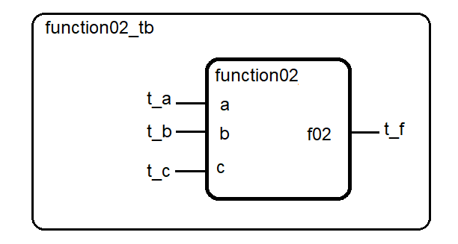
Building and testing digital circuits
2 files
Digital circuit function02.v Logic for circuit
Testbench function02_tb.v Test inputs for circuit

Slide 6
Circuit – code for gates
Concurrent assignment statements
assign p1 = ~a & ~b & c;
assign p2 = ~a & b & ~c;
assign p4 = a & ~b & ~c;
assign p7 = a & b & c;
assign f03 = p1 | p2 | p4 | p7;
All lines of code happen at the same time concurrent
All lines of code happen all the time continuous

Slide 7
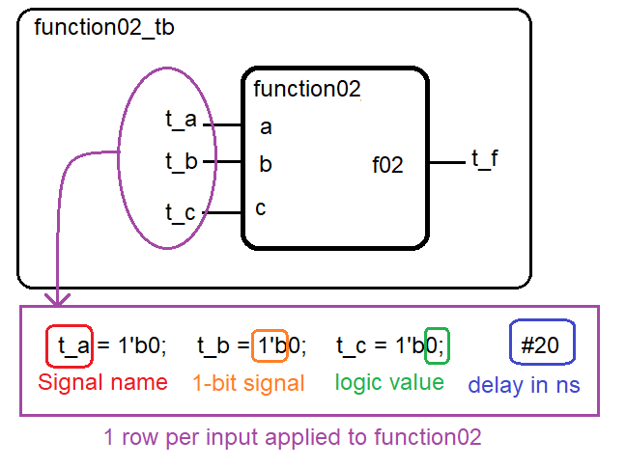
Testbench – driving inputs to circuit

Slide 8
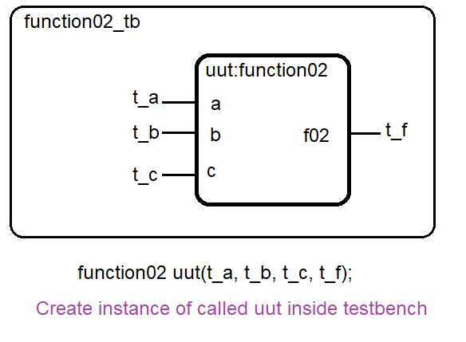
Testbench – instantiation of test circuit

Slide 9
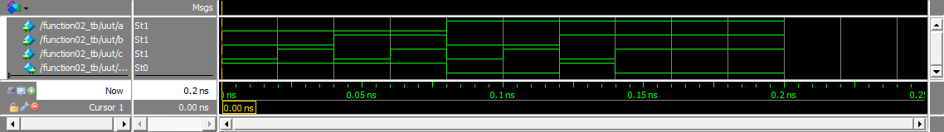
Circuit - output
Timing diagram – logic level vs. time
(a,b,c) = (1,1,0) what is f equal? Yes, f is the bottom trace.

Slide 10
Installing Quartus Prime lite 24.1
Go to course canvas module: Labs
Find the pdf document ‘How To 1 - Installing Quartus’, complete all the steps.
Find the pdf document ‘How To 2 - Creating a Project’, complete all the steps.
Find the pdf document ‘How T 3 – Performing a Simulation’, complete all the steps.
If you see the expected timing diagram at the end of simulation, your set up is complete. You will now be able to complete simulation component of labs anytime!

Slide 11
Installing Quartus Prime lite 24.1
Please complete the installation before next week.
Quartus prime lite will not work on iOS; use a lab computer.

Slide 12
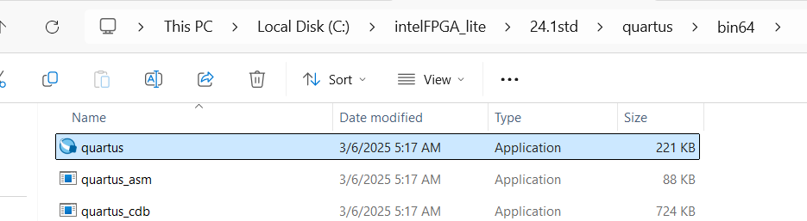
Launching Quartus Prime lite 24.1
On Lab computers
C:\intelFPGA_lite\24.1std\quartus\bin64\quartus.exe
This should launch Quartus Prime lite 24.1. You can also navigate to
C:\intelFPGA_lite\24.1std\quartus\bin64 and double click to open the executable application quartus.

Slide 13
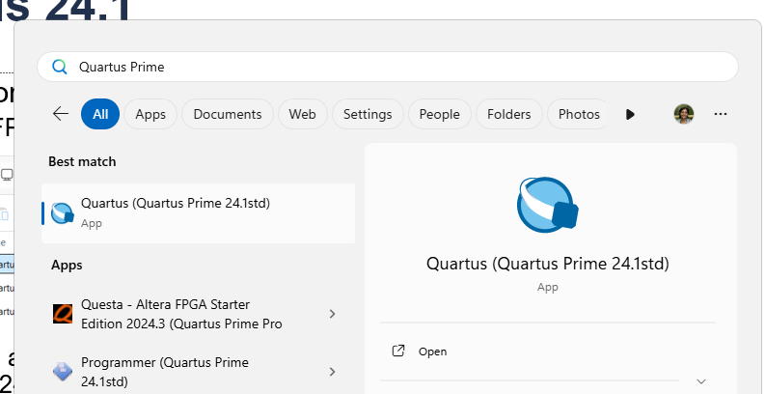
Launching Quartus Prime lite 24.1
On Lab computers
You can also search for ‘Quartus Prime‘, and make sure you open version 24.1
If there are multiple version of Quartus on the computer, open the latest version 24.1
Do not launch the Programmer which might show up as a top choice in your search result
Notes:
As we recently had version 24.1 installed, it might not show up in search as the top choice. Make sure you type ‘quartus prime’ in the search option to see the latest version. Also, do not chose the programmer, you want to launch the executable app that you can recognize by the blue icon
This might only happen the first few times till the cache is updated and 24.1 starts showing up as a top choice in the search options

